Slide 1

RESUME CLASSIFIER
Advanced Python –CIS008
Group 3: Engelbert Ray Velasquez Mariano • Shraddha Patel • Mohamad Omer
Github=https://github.com/Shraddha25121996/Resume_Clarification
AdvancedPythonProject_Group3

Slide 2
Introduction: What is Resume Classification?
Resume classification is the process of automatically categorizing job applications into specific career fields
In today's digital hiring landscape, organizations receive thousands of applications daily from diverse candidates
Manually reviewing each resume is impractical and inefficient, making automation essential for modern HR departments
Our Resume Classifier uses AI and Machine Learning to intelligently sort and match resumes with job categories

Slide 3
Introduction: The Modern Hiring Challenge
1
Volume Explosion
Companies receive 100-1000+ applications per position
2
Time Constraint
Limited HR staff cannot review all applications
3
Quality Loss
Many qualified candidates slip through screening
4
Bias & Inconsistency
Human reviewers may show unconscious biases

Slide 4
Problem Statement: The Challenge
HR departments struggle with overwhelming volume of resume submissions in competitive job market
Manual resume screening is time-consuming, often taking days or weeks to process applications
High costs of human resource allocation for screening directly impact recruitment budgets
Human reviewers may overlook qualified candidates or demonstrate unconscious bias in selection

Slide 5
Problem Statement: Why It Matters
Business Impact
Opportunity
Cost per hire increases with manual screening
Hiring cycle takes 40+ days for most companies
Lose top talent to competitors during screening
HR teams burnout from repetitive tasks
Implement AI to reduce screening to seconds
Free up HR staff for strategic decisions
Improve candidate quality and hiring cycles
Create fair and objective evaluation criteria

Slide 6
Project Definition: Our Solution
An AI-powered intelligent system that classifies resumes into different professional career categories
Uses machine learning (Logistic Regression) combined with Natural Language Processing (NLP) techniques
Processes resume text through TF-IDF vectorization to extract meaningful features and patterns
Includes intuitive web-based interface for real-time resume classification and candidate management

Slide 7
Use Cases & Real-World Applications
🏢
🤝
Large Corporations
Recruitment Agencies
Screen thousands of applications monthly
Match candidates with job openings
📊
🎓
Job Portals
Academic Institutions
Categorize resumes for better search
Process student applications

Slide 8
Project Importance & Benefits
1
Time Efficiency
Process 100+ resumes in seconds instead of hours
2
Cost Reduction
Decrease HR resource allocation and recruitment costs
3
Better Matching
Ensure qualified candidates reach right teams
4
Scalability
Handle unlimited volumes of applications
5
Data Insights
Analyze candidate skills and hiring trends

Slide 9
Key Benefits & Metrics
⚡
🎯
🔧
Speed
Accuracy
Usability
Instant classification
65% model accuracy
Intuitive interface
📊
🤖
🔐
Analytics
Intelligence
Reliability
Skill tracking
ML-powered
13/14 skills matched

Slide 10
Technologies & Libraries Used
Language
Python 3.13
IDE
Jupyter Notebook
Data Processing
Pandas, NumPy
ML Framework
Scikit-learn
NLP Tools
NLTK, TF-IDF Vectorizer
Web Framework
Django
Frontend
HTML5, CSS3, JavaScript
Database
MySQL

Slide 11
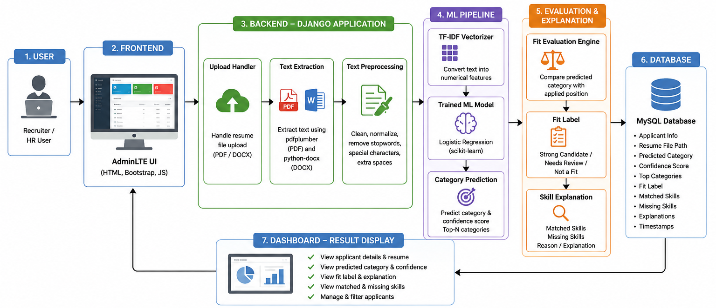
Architecture

Slide 12
Future Scope & Enhancements
Advanced ML Models: Neural Networks and Deep Learning (LSTM, BERT) for improved accuracy
Multi-language Support: Classify resumes in 20+ different languages
Resume Enhancement: Suggest improvements and keyword optimization
Database Integration: Store and analyze resume trends with analytics
Mobile Application: Native iOS and Android apps for on-the-go screening
Real-time Dashboard: Analytics, hiring metrics, and recruitment ROI tracking
Semantics Skills Matching
Improved OCR

Slide 13
Conclusion
The Resume Classifier demonstrates the transformative power of Machine Learning and AI in modern Human Resources.
By combining NLP, TF-IDF vectorization, and Logistic Regression, we have created an efficient, scalable solution that streamlines resume screening and enables faster, more objective hiring decisions.
This project exemplifies real-world applications of Python, data science, machine learning, and web development—skills essential for tomorrow's technology professionals.
Thank You

